Slide 1

Movie Analytics: Box-Office Success Factor
A Data Driven Study of Bollywood Movies
- By Sakshi A

Slide 2
Agenda
1
2
3
4
5
Introduction
Dataset Overview
Infographics
Key Insights & Recommendations
A Thought

Slide 3

Introduction
In an industry where content meets commerce, understanding the drivers of movie success is crucial. This project explores the performance of Bollywood movies using data analytics and visualization to uncover the factors influencing box office collections. The insights are derived from exploratory data analysis (EDA), visual dashboards, and predictive modeling.

Slide 4


Dataset Overview
Source : Bollywood Movie Analytics . csv
Size : 529 Movies , 15 Features
Features Analyzed : Genre, Director, Budget, BoxOffice_INR, IMDb & TMDB Ratings, Language, Duration, Release Month.
The dataset is comprehensive and includes both numeric and categorical data that enable performance benchmarking and predictive modeling.
4
Movie Analysis : Box-Office Success Factor
2025

Slide 5

Infographics

Slide 6

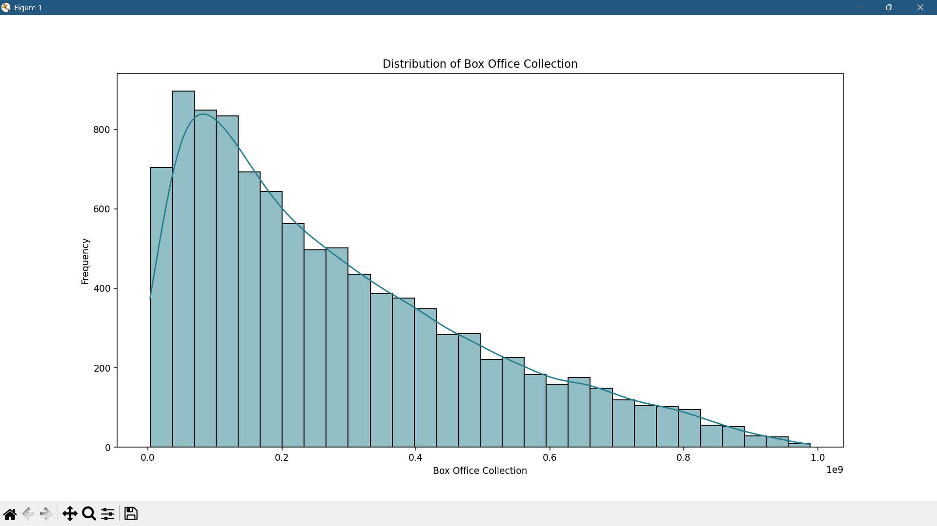
Box-Office Collection Distribution
Key Points:
Right-skewed distribution
Majority of films earn below the average
Few blockbusters earn significantly higher
Bollywood revenue follows a “power-law ” distribution. Most films earn modestly, and very few dominate the box office.

Slide 7

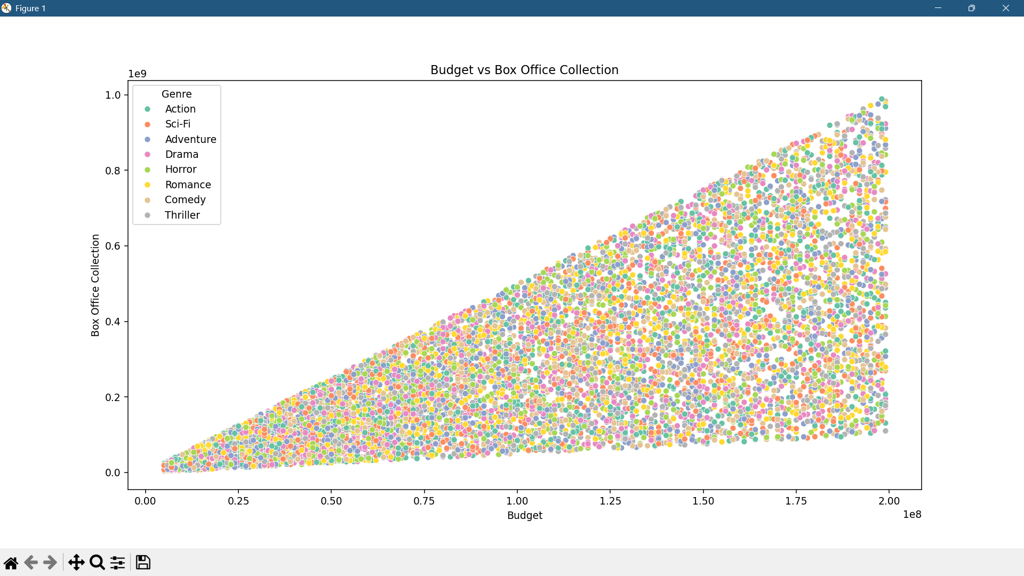
Budget vs Box-Office
Positive Trend Exists: As the movie budget increases, the box office collection also tends to increase.
Low-Budget High Performers (Sleeper Hits): Some movies with low budgets still earned exceptionally well.
3. Genre-Based Spread: Different genres form clusters:
Thrillers and Dramas are well-distributed across budgets and perform consistently.
Comedy and Horror are often lower in both budget and returns.
The scatter plot confirms that budget has a significant, but not deterministic, impact on box office collections. While larger budgets enable better production and promotion, audience engagement, content quality, genre alignment, and timing are equally crucial for commercial success.

Slide 8

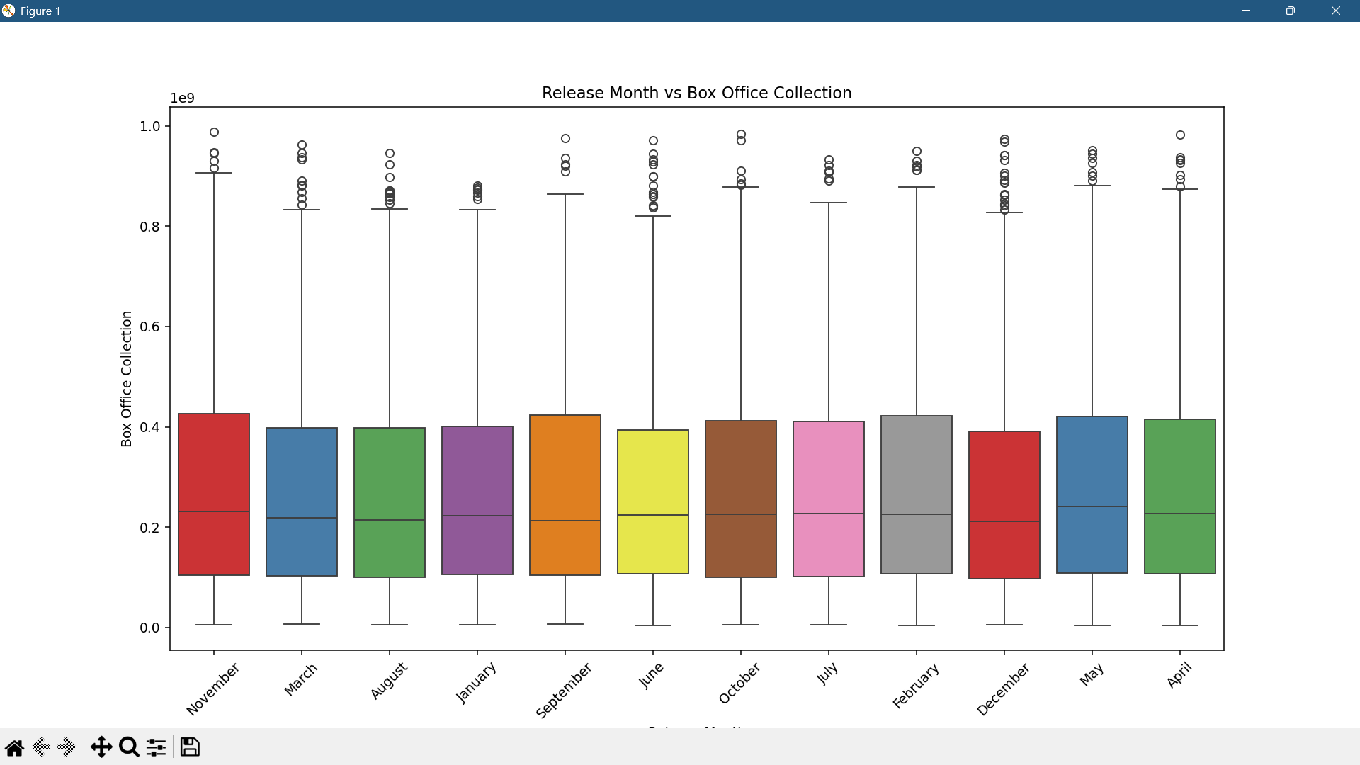
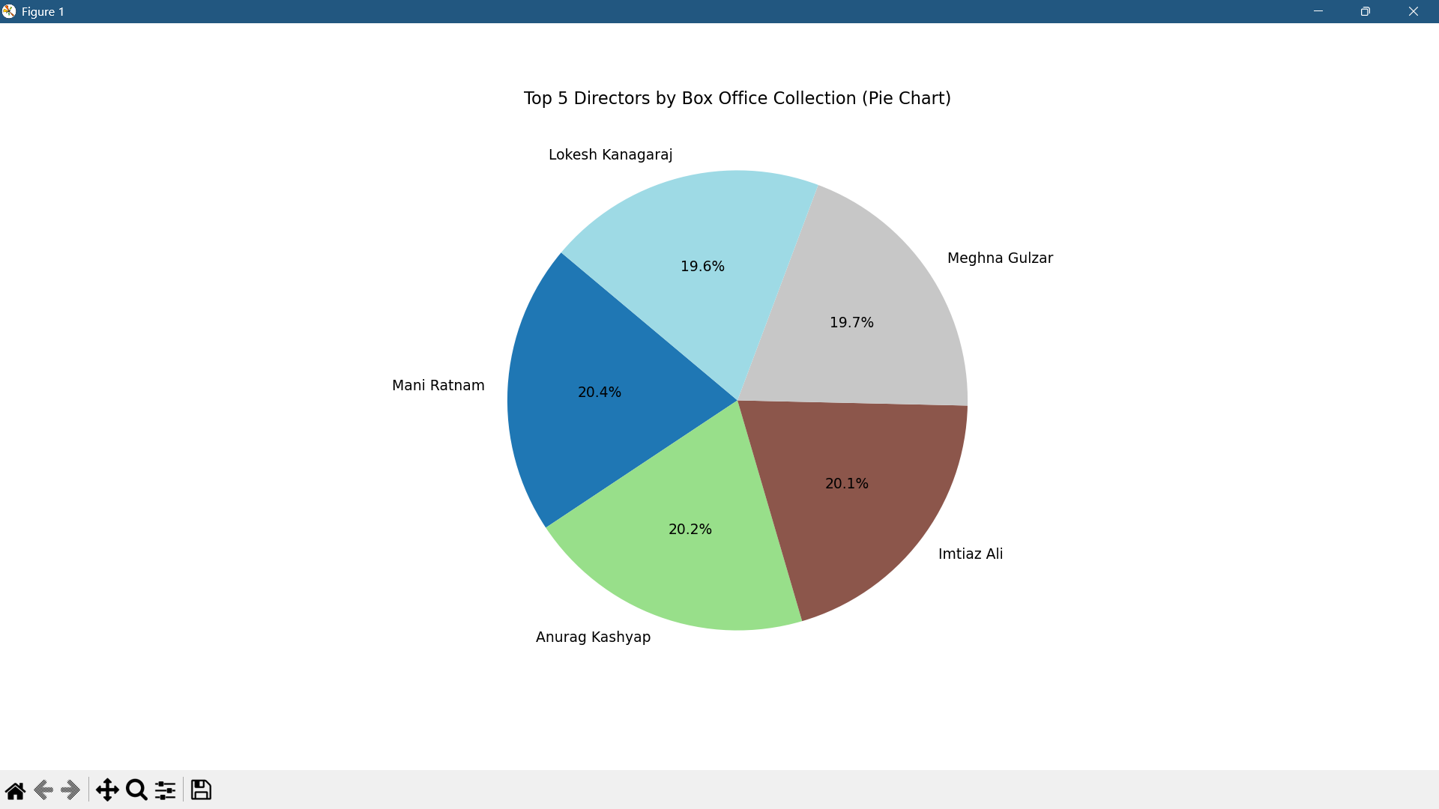
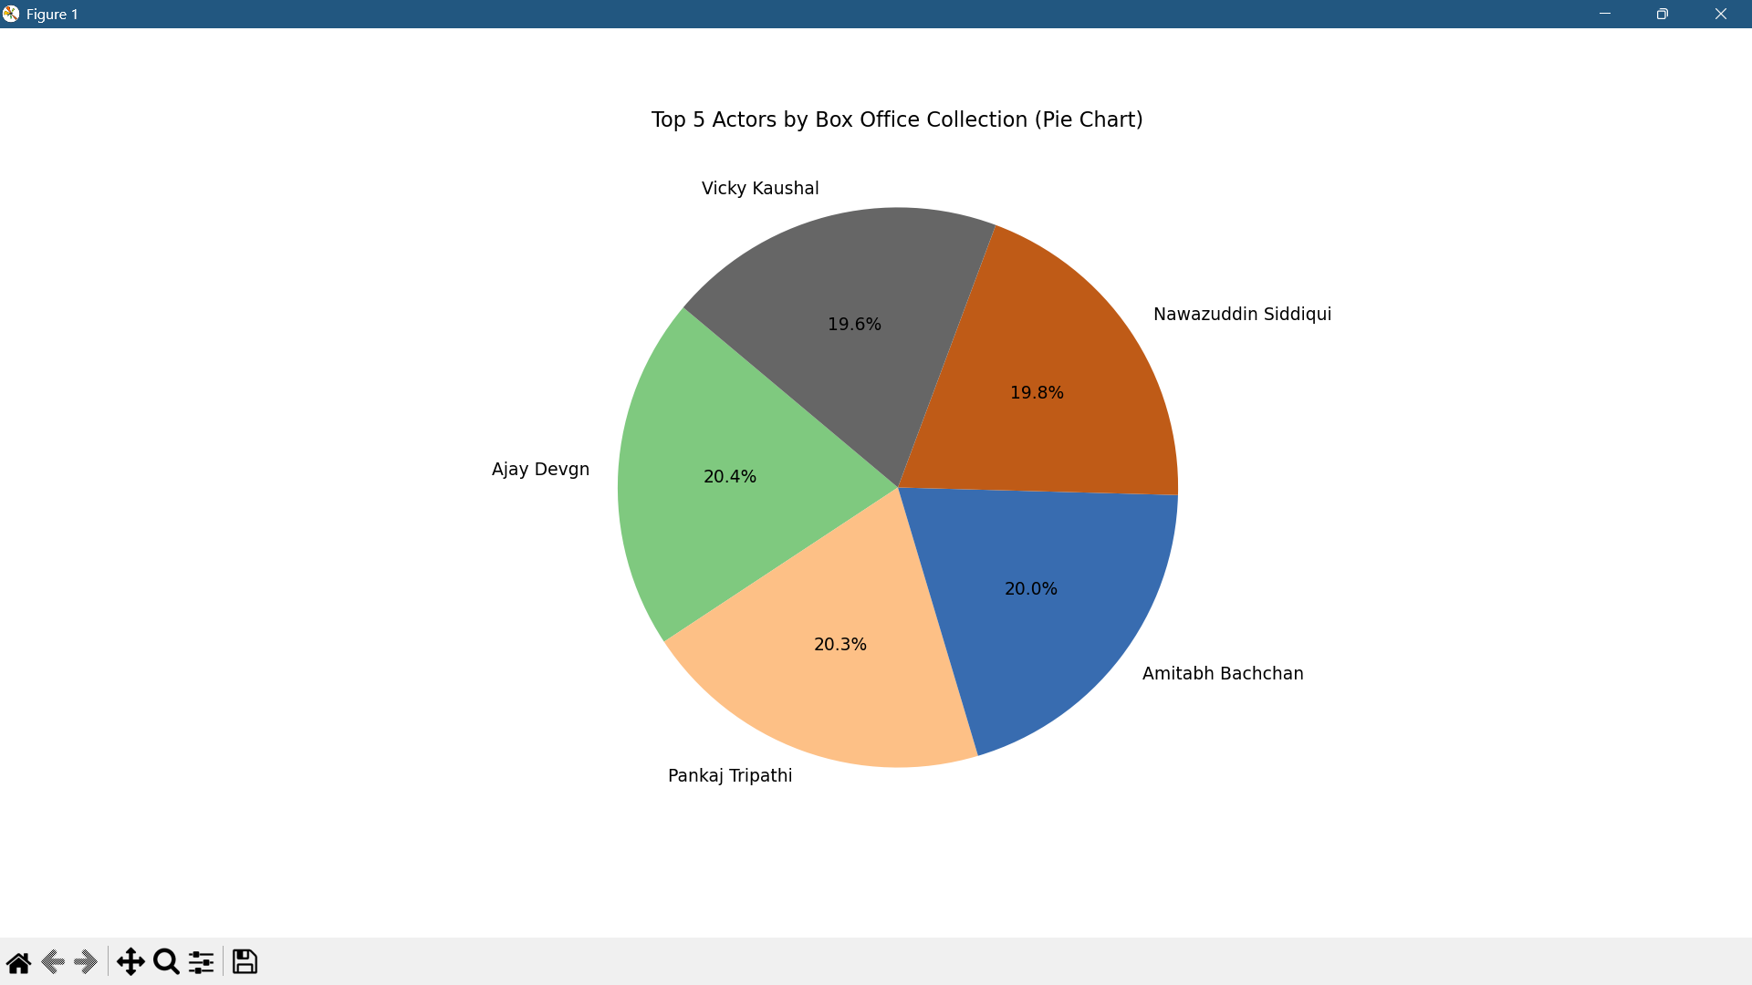
Actors , Directors & Box-Office Collection
Simple Key Points:
Collections are fairly consistent across months.
May, April, and November show slightly better performance.
Every month has outliers (hit films).
No month guarantees success—content matters more.
Simple Key Points:
Mani Ratnam and Anurag Kashyap are top revenue-generating directors.
Director impact is nearly equal among the top 5.
Shows that experienced directors drive stronger box office.
Choosing the right director adds value and reduces risk.
Simple Key Points:
Ajay Devgn and Pankaj Tripathi lead in box office earnings.
Star power is evenly spread—multiple actors are high performers.
Popular actors can boost opening collections.
Casting matters for both marketing and audience pull.

Slide 9
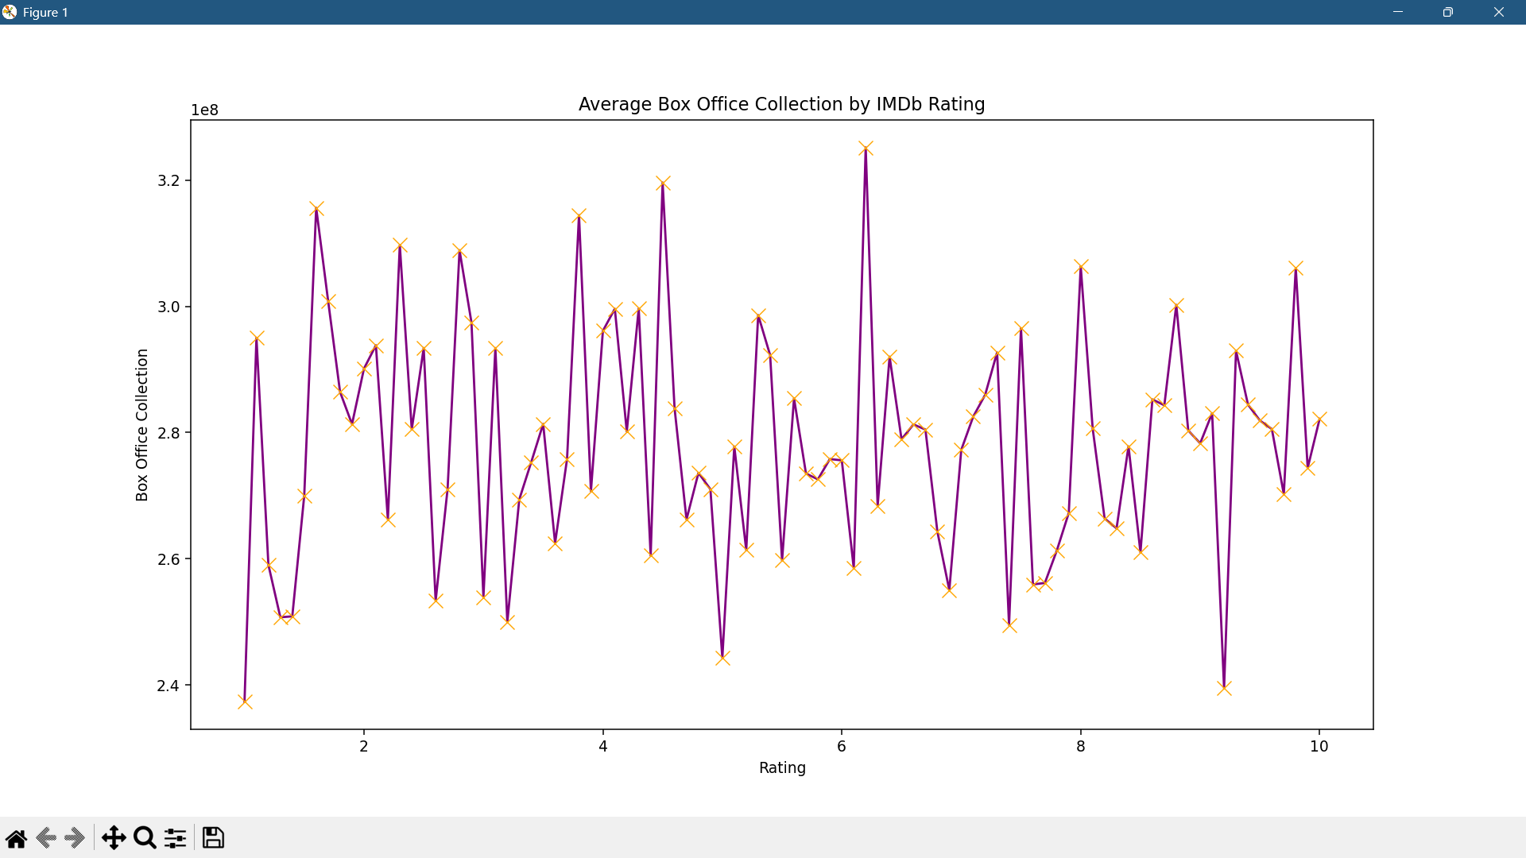
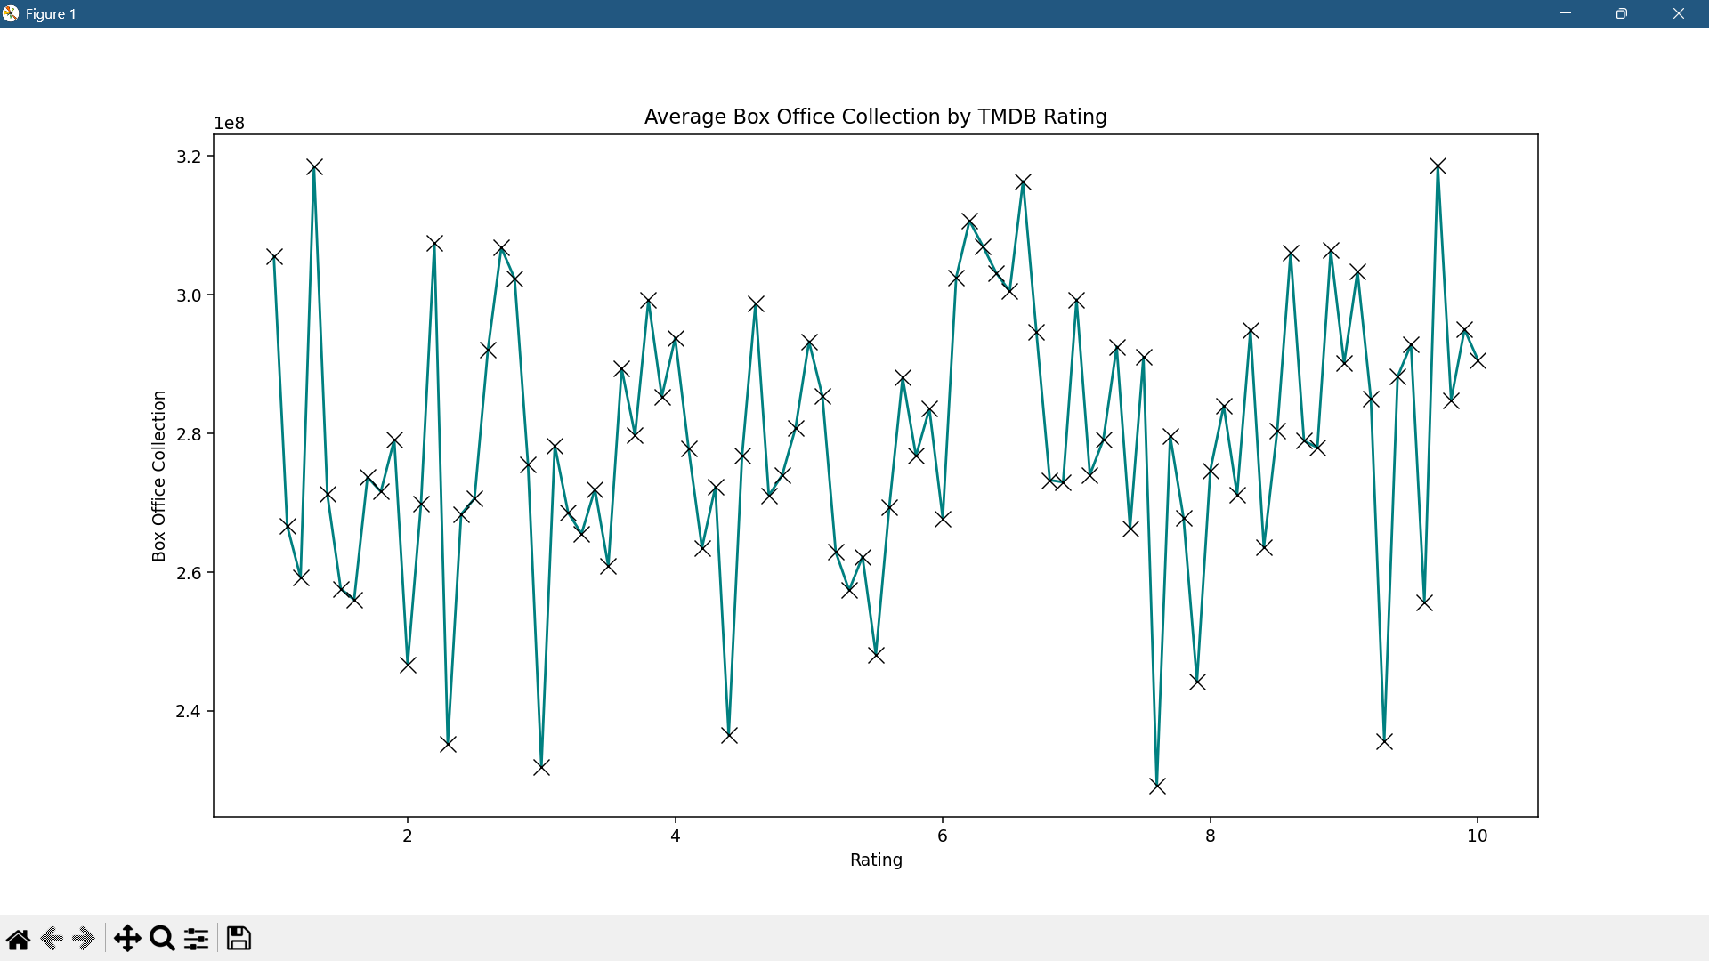
IMBD & TMDB Ratings vs Box-Office
Higher ratings tend to cluster around higher collections.
Ratings between 6 and 9 seem to produce relatively stable and better-performing results compared to extreme low or high ratings.
The graph shows slightly smoother fluctuations than IMDb, though it still has notable spikes and drops.
A general upward bias is visible from rating 5.5 to 9, indicating that better-rated movies gradually earn more.
Chief Executive Officer
Chief Operations Officer

Slide 10
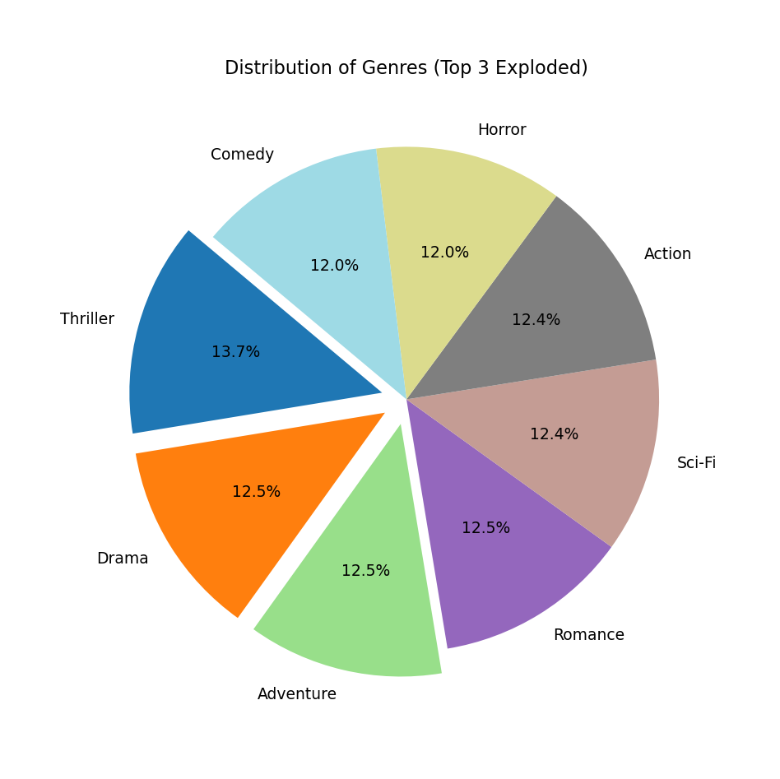

Genre : Distribution and Performance
Top genres: Drama, Thriller, Adventure
Thriller and Drama have the highest collections
Comedy and Horror underperform despite frequency
Genre significantly impacts success. Thrillers and Dramas are safer bets commercially.
10

Slide 11
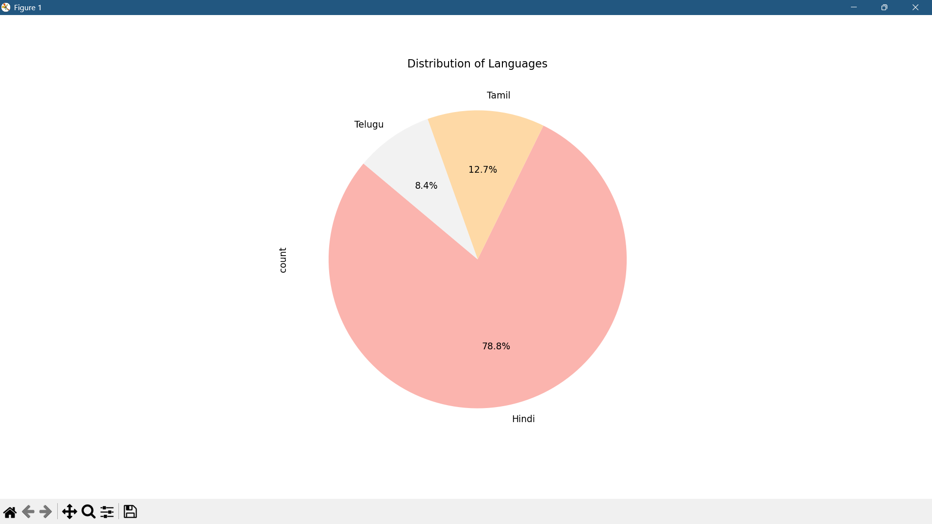
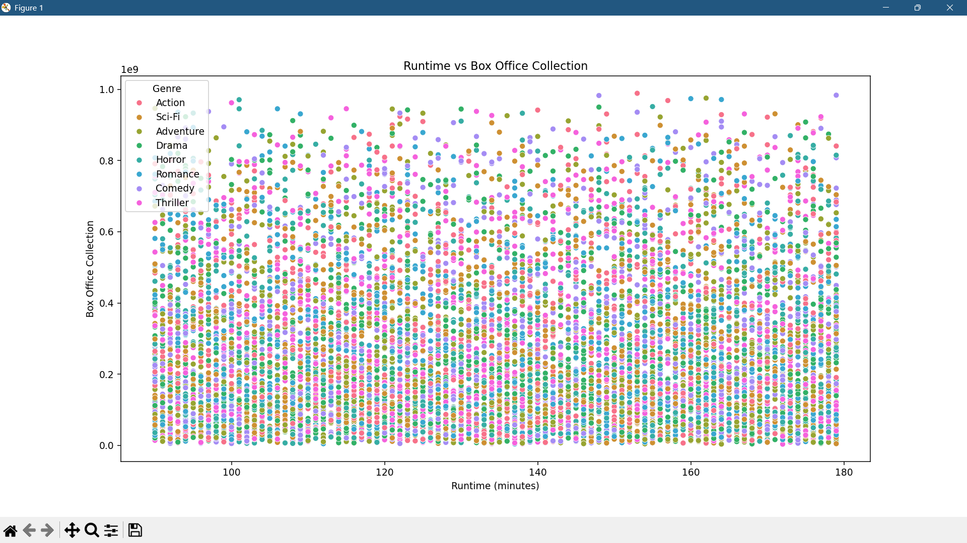
No Strong Linear Correlation
Observation: The data points are widely scattered across all runtime values.
Conclusion: Runtime does not have a strong direct influence on box office earnings.
Implication: Simply increasing or decreasing a film’s duration won't necessarily improve revenue.
Runtime & Language Analysis
Hindi is the Dominant Language
While Indian cinema is linguistically diverse, this dataset likely focuses on films distributed under the “Bollywood” umbrella, where Hindi is predominant. Hindi dominates Bollywood cinema, but the emerging strength of regional language content—especially in OTT and dubbed forma—indicates a growing opportunity.
Runtime alone does not dictate box office performance. While most successful films fall within the 120 – 160 minute range, high-grossing exceptions at both ends prove that engagement matters more than length. The focus should be on content quality, genre alignment, and audience expectations, not duration.
Strategic Implication for Filmmakers
Insight: New productions aiming at pan-India success should consider multi-language releases (a strategy common in Tamil/Telugu industries).
Conclusion: Expanding language diversity may increase reach and revenue—especially in southern and eastern markets.
Strategic Insights:
Optimal runtime range
Avoid overemphasizing duration in success planning
Tailor runtime by genre

Slide 12
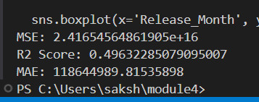
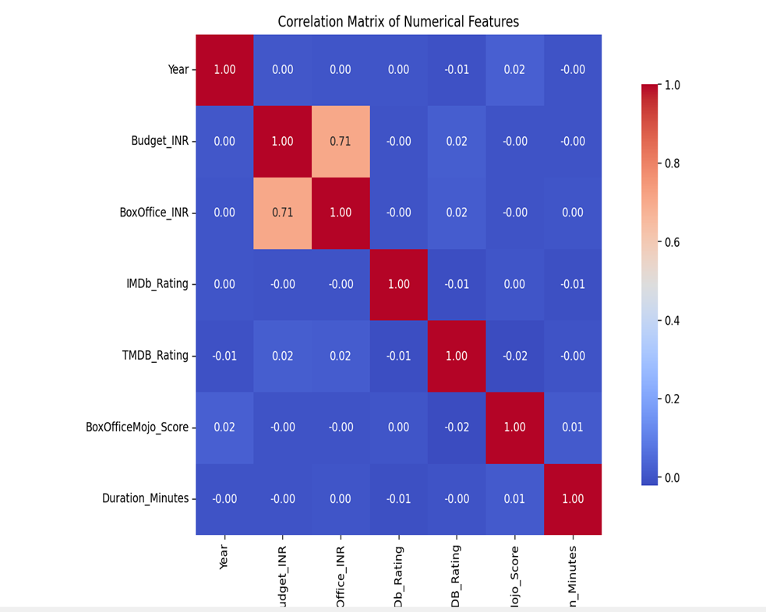

Correlation & Predictive Modeling
Budget is the most reliable numeric predictor of box office performance. Ratings and runtime are supportive factors that may influence success through audience sentiment rather than direct numerical impact.
The model is effective at forecasting general box office performance, especially for average-range films.

Slide 13
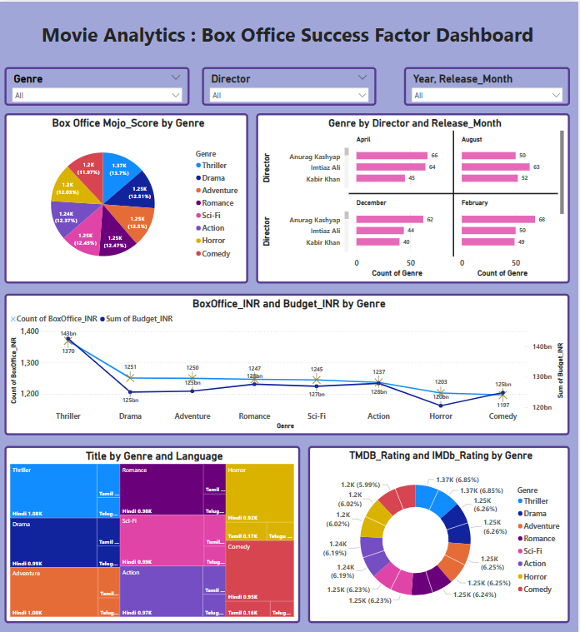
The Box Office Success Factor Dashboard provides a concise visual analysis of factors influencing Bollywood movie performance. It highlights that Thriller and Drama genres consistently yield higher box office returns, while Comedy and Horror tend to underperform. The Budget vs. Box Office chart reveals a moderate positive correlation, suggesting that higher investment often results in better revenue, especially within top genres. The director and release month analysis shows that some directors, like Anurag Kashyap, prefer specific months such as April or December—indicating a pattern that could be strategically leveraged. The dashboard also emphasizes that Hindi dominates the language landscape, but genre diversity remains broad. Additionally, audience ratings (IMDb and TMDB) reinforce the success of critically appreciated genres, particularly Thriller and Drama. Overall, the dashboard serves as a comprehensive tool to explore the relationship between content, timing, and commercial outcomes in Bollywood cinema.

Slide 14

Key Insights & Recommendations
Leverage Director Trends Analyze and schedule based on a director’s historical seasonality.
Extend to OTT Performance Comparing box office vs. OTT success could offer even deeper business intelligence.
Strategic Release Timing Aim for December, August, and festive periods for major launches.
Include Marketing/Star Cast Data (Next Phase) Future work could incorporate trailer views, cast , media
& popularity.
Focus on Top-Performing Genres Thriller, Drama, and Adventure outperform consistently.
High Budget + High Ratings = High Revenue Invest in quality production and talent to maximize returns.

Slide 15

Data tells you where the money went—Story tells you why it mattered.
“
One Line, Big Insight
”

Slide 16

THANK YOU

